Slide 1

Python for .NET

Slide 2
About Me
Software Developer at United Shore
About 2 years of professional experience
email: hmfarran@gmail.com
github: ijwu
Notes:
Slide time estimation: 2m
Name
Experience
Contact info
Short blurb:
I went through the ExperienceIT program in Grand Circus (just down the street, haha)
I got picked up by UseTech through the program.
I’ve been at UseTech for a year now.

Slide 3
IronPython
IronPython implements the Python API on the CLR
Includes the full power of the CLR including GIL-less threading
(Eventually) compiles down to CIL

Slide 4
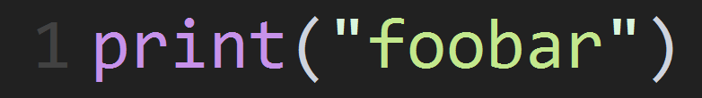

Slide 5
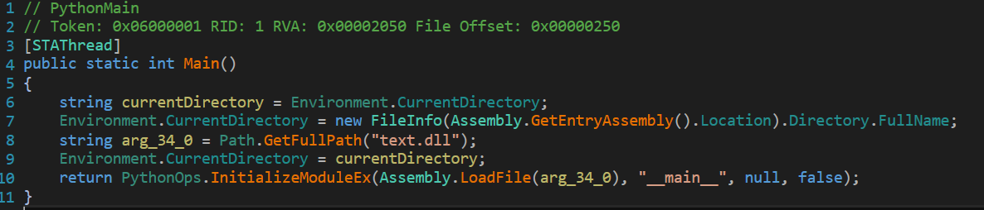

Slide 6
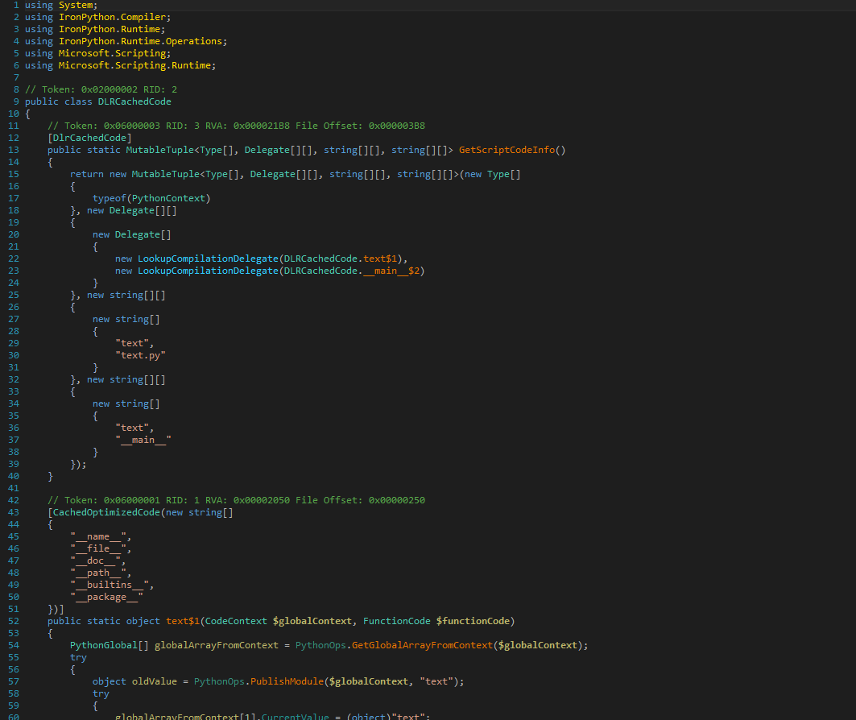

Slide 7
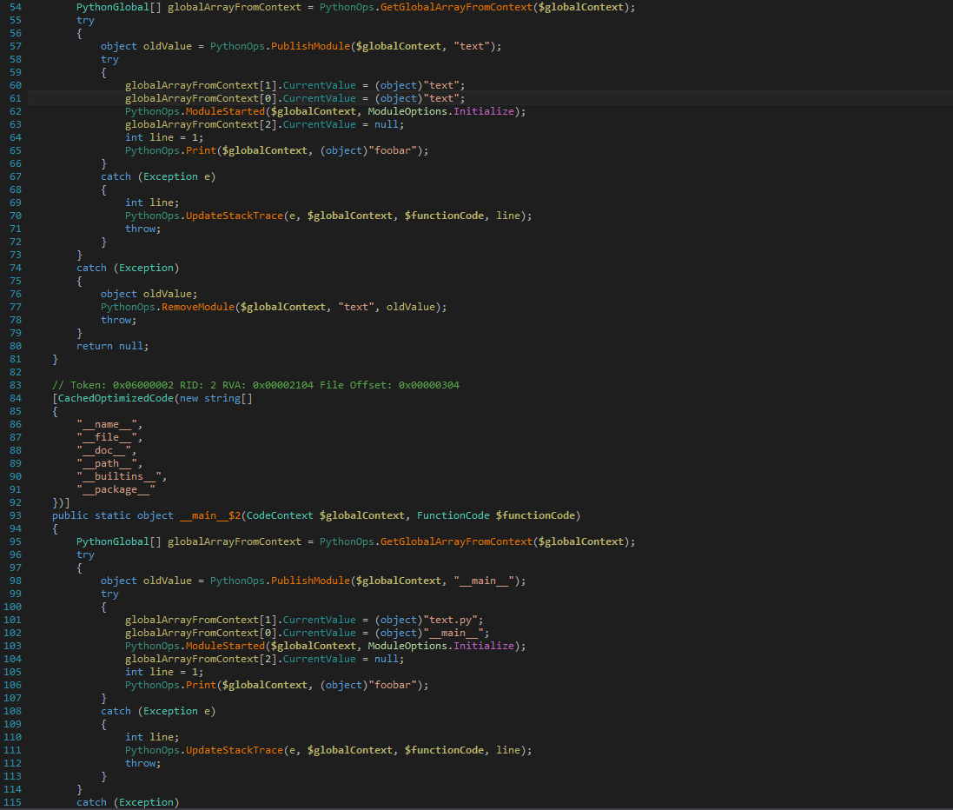

Slide 8
Python for .NET
Python for .NET accesses the CPython C API from the CLR
Runs the CPython runtime directly.
Allows access to CPython C extensions.
No way around the GIL

Slide 9
Installing Python for .NET
`pip install pythonnet`
`import clr`

Slide 10
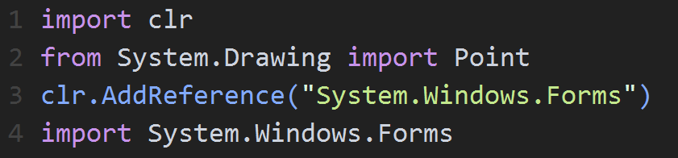
Imports
`clr` module
.NET namespaces may be imported like typical Python modules

Slide 11
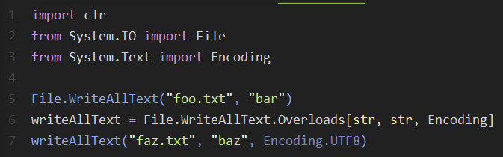
Classes
Same class instantiation syntax as Python
`Overloads` collection for overload resolution

Slide 12
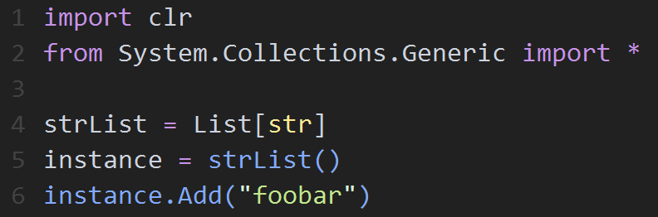
Generics
Can bind a generic type to an identifier before use
Same goes for methods

Slide 13
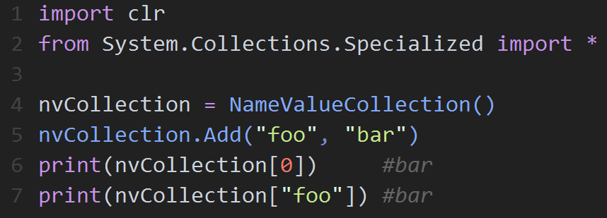
Fields, Properties, and Indexers
.NET fields and properties are treated like normal Python fields
Overloaded indexers are supported

Slide 14
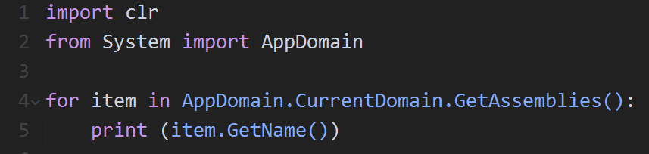
Collections
Managed objects which implement IEnumerable may be enumerated from within Python

Slide 15
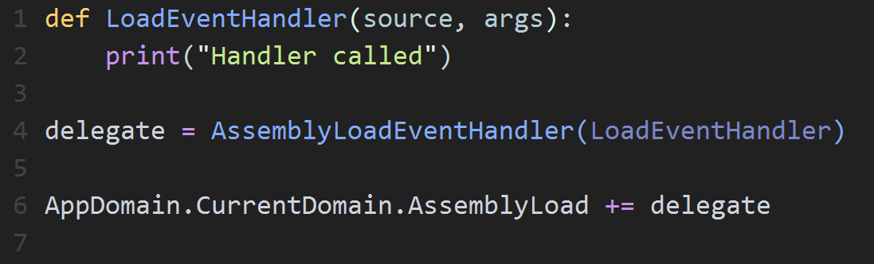
Delegates
Delegates can be handed Python functions without issue
As long as the Python function has the same parameter count as the delegate

Slide 16
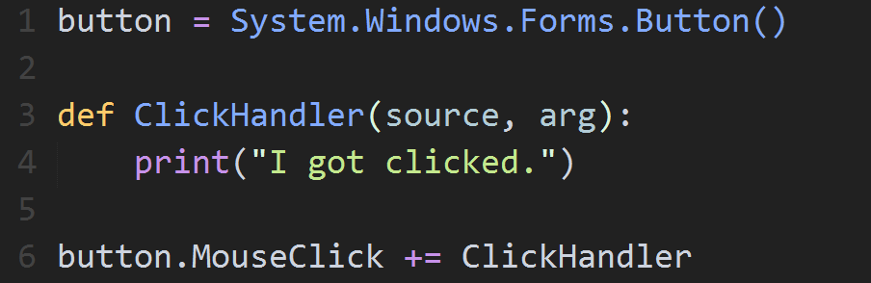
Events
Register event handlers like you would in C#
Also supports implicit delegate casting

Slide 17
Embedding Python in your C#
Run code strings through the python engine
Import modules through the python engine
Point the engine to a file and run it directly

Slide 18
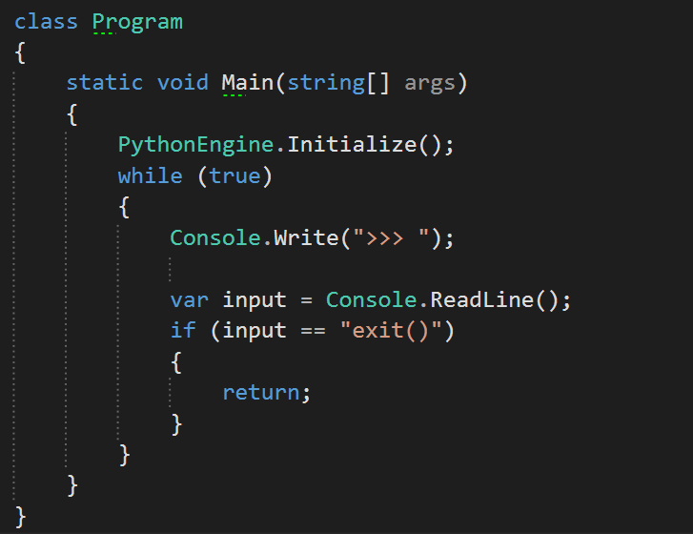
Building a REPL

Slide 19
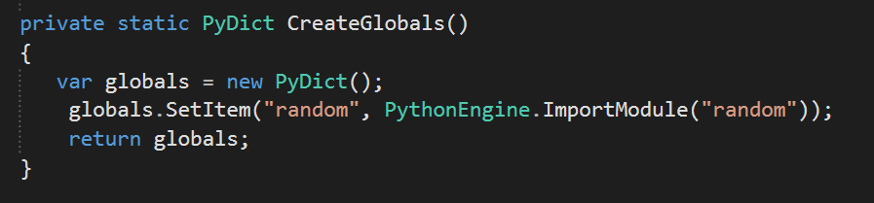
Create Globals
This is also how you would sandbox your scripts.

Slide 20
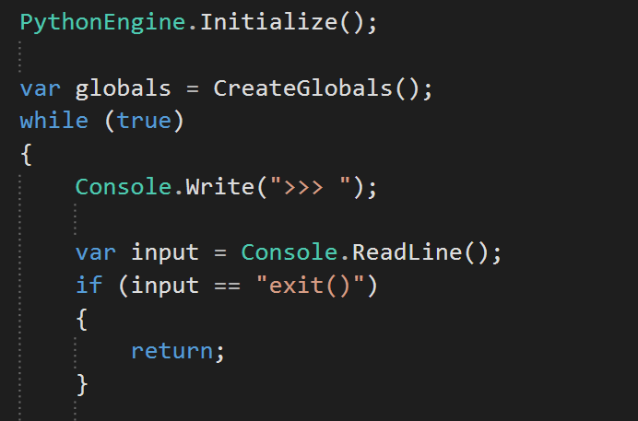
Get Our Globals

Slide 21
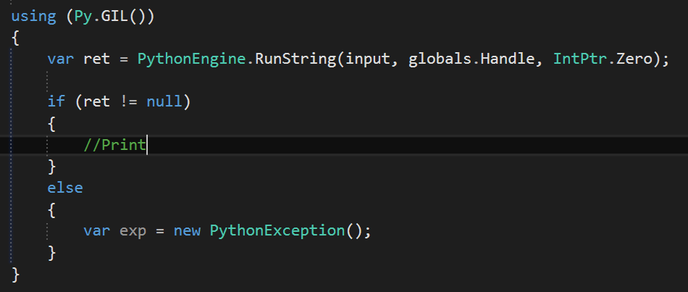
Run Entered Code

Slide 22
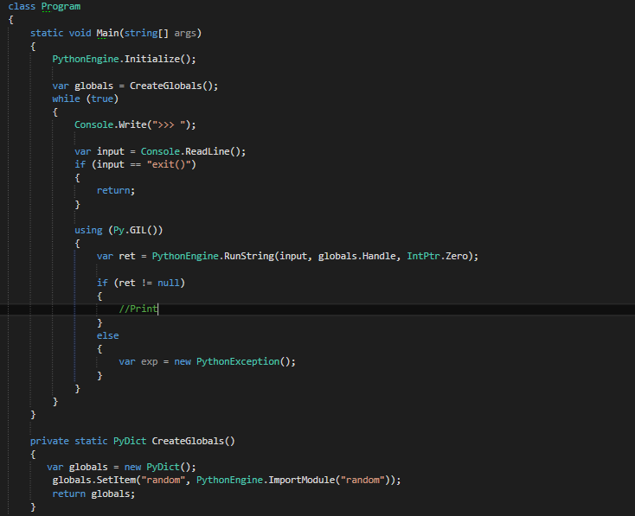

Slide 23
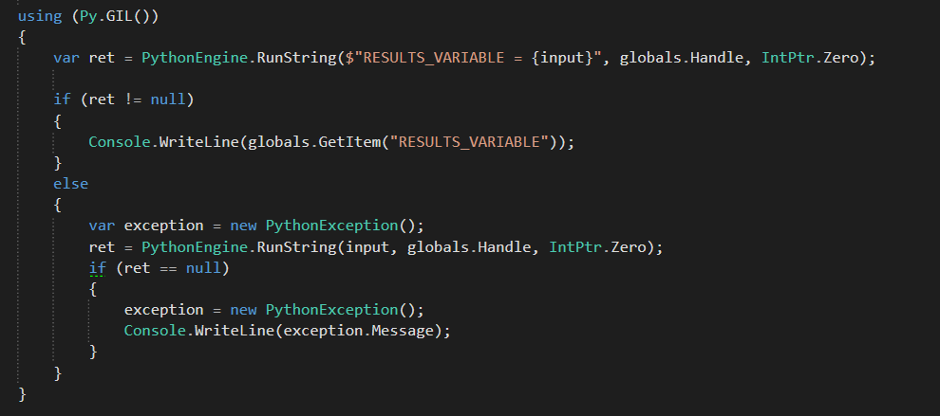
Getting Our Results

Slide 24
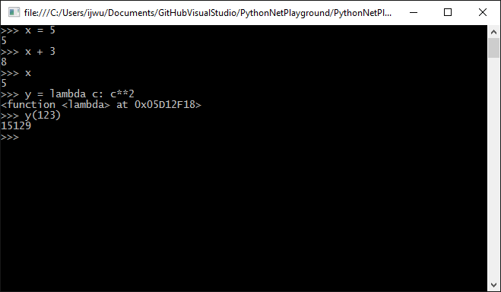
Results

Slide 25
Sandboxing
We’ve already done this.
Remember this code?

Slide 26
Let’s use Jinja2 in ASP.NET MVC
Replacing Razor view engine with a Jinja2 view engine
Use Python to render our Jinja2 views
Jinja2 or an equivalent is not available in .NET
Why not?

Slide 27
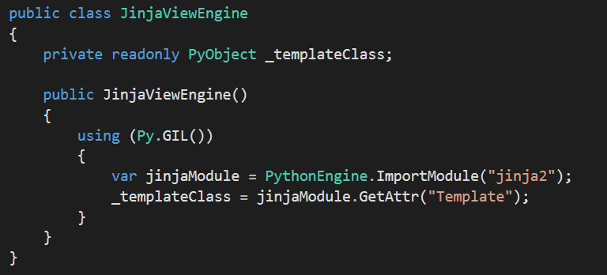
Let’s make a view engine

Slide 28
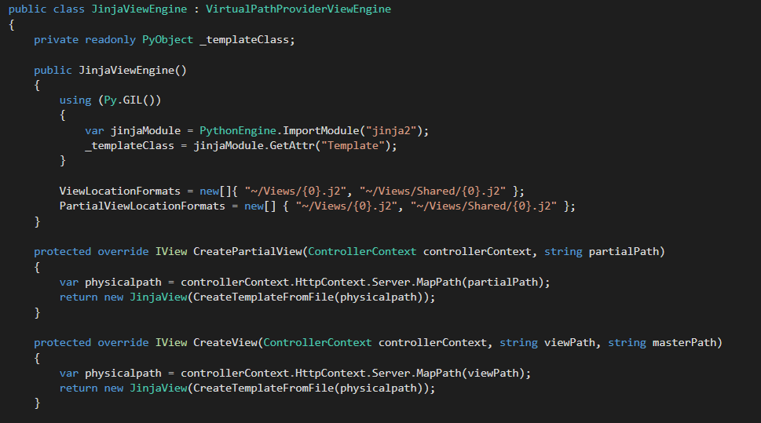
Let’s make it official

Slide 29
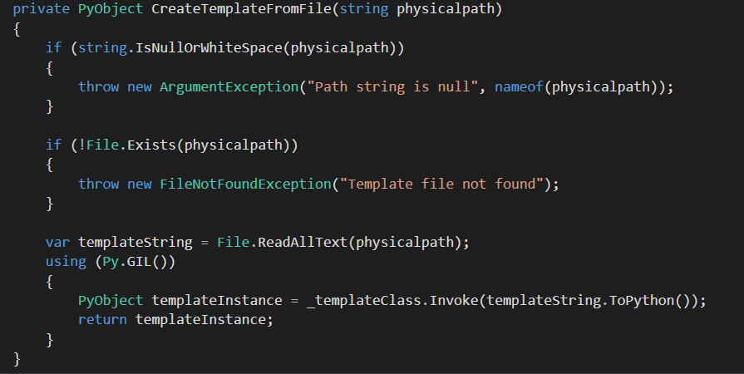
Helpers

Slide 30
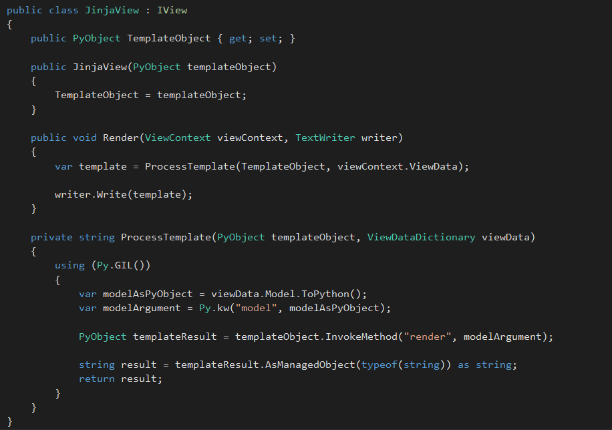

Slide 31
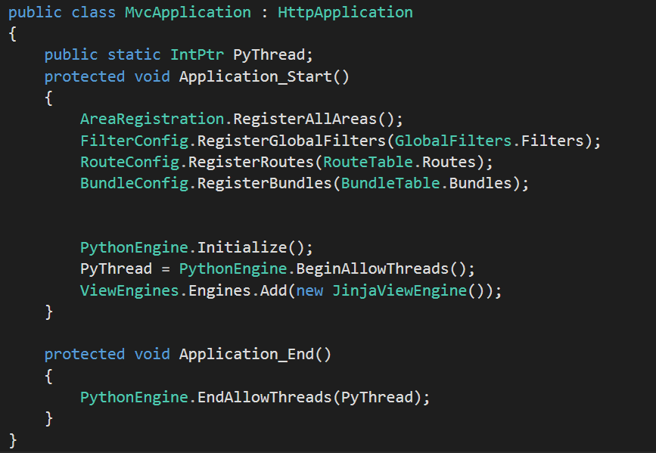

Slide 32
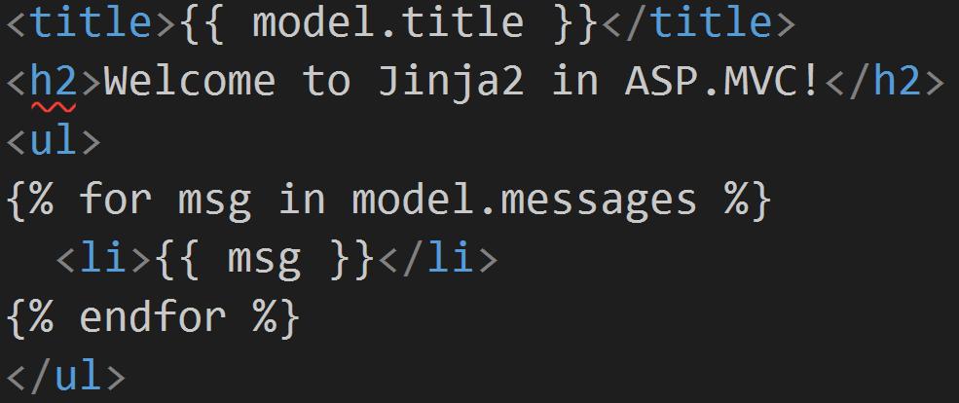
Our Template

Slide 33
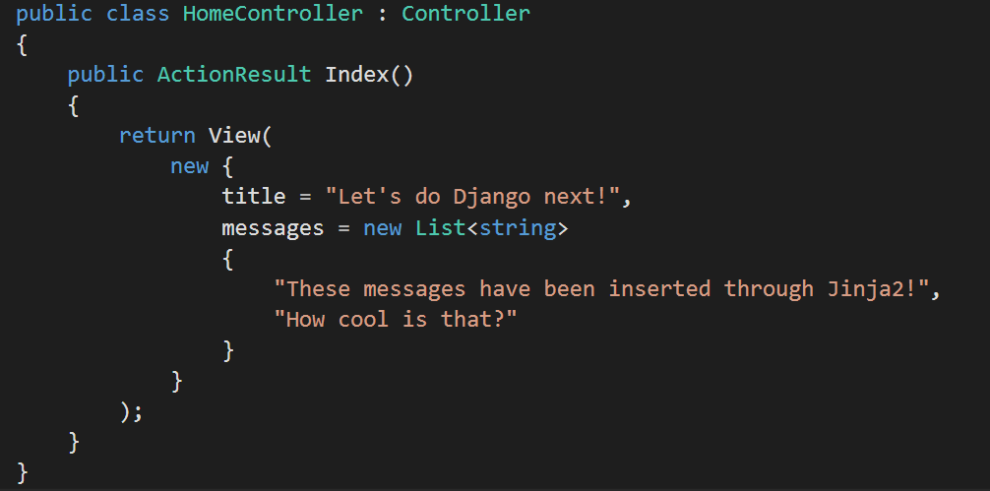
Getting in Control

Slide 34
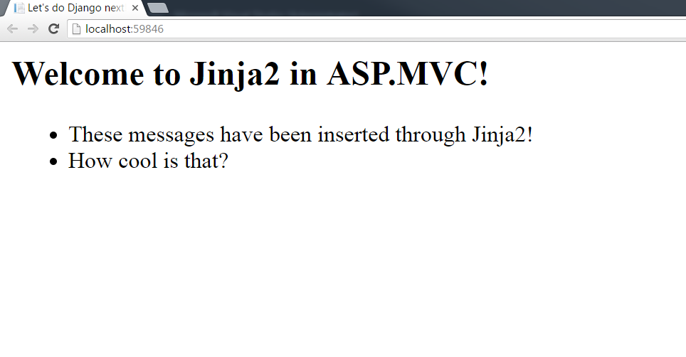

Slide 35
Contact Me
Feedback Appreciated!
hmfarran@gmail.com
github.com/ijwu

